Slide 1

Banking International Payments
SWIFT

Slide 2
SWIFT – Society For Worldwide Interbank Financial Telecommunications
SWIFT stands for the Society for Worldwide Interbank Financial Telecommunications. It is a messaging network that financial institutions use to securely transmit information and instructions through a standardized system of codes.
SWIFT assigns each financial organization a unique code that has either eight characters or 11 characters.
Example of Swift Code : Citibank USA – CITIUS33
First 4 Characters – Bank Code (only letters)
Next 2 Characters - ISO 3166-1 alpha-2 country code (only letters)
Next 2 Characters - location code (letters and digits)
Last 3 Characters – branch code (letters and digits)

Slide 3
Benefits of SWIFT
There are a number of known benefits for using SWIFT:
Transparency. SWIFT payments clearly detail the amounts involved in the transaction, the route it takes between banks, the details of all charges and the nature of the payment (along with many other details). This information allows all parties involved to track the transaction and to understand the costs and time period involved.
Traceability. Because SWIFT details the route of the transaction between banks and the amount of money involved, it provides clear and recognized proof of payment.
Consistency. Due to the consistency of how messages are structured, payment information is easy to decipher regardless of country or language barriers.

Slide 4
Correspondent Bank
A correspondent bank is a financial institution that provides services on behalf of another financial institution. It can facilitate wire transfers, conduct business transactions, accept deposits and gather documents on behalf of another financial institution. Correspondent banks are most likely to be used by domestic banks to service transactions that either originate or are completed in foreign countries, acting as a domestic bank's agent abroad.
Generally speaking, the reasons domestic banks employ correspondent banks include:
limited access to foreign financial markets and the inability to service client accounts without opening branches abroad,
act as intermediaries between banks in different countries or as an agent to process local transactions for customers abroad,
accept deposits, process documentation and serve as transfer agents for funds.
The ability to execute these services relieves domestic banks of the need to establish a physical presence in foreign countries.

Slide 5
Transferring Money through Correspondent Bank
International wire transfers often occur between banks that do not have an established financial relationship. When agreements are not in place between the bank sending a wire and the one receiving it, a correspondent bank must act as an intermediary. For example, a bank in Geneva that has received instructions to wire funds to a bank in Japan cannot wire funds directly without a working relationship with the receiving bank.
Most if not all international wire transfers are executed through SWIFT. Knowing there is not a working relationship with the destination bank, the originating bank can search the SWIFT network for a correspondent bank that has arrangements with both banks.
Interestingly, when a bank wants to send some funds to another bank on the other side of the world, it happens often that the sending bank has no banking relationships with any bank having itself a relationship with the target bank. In this case, the order needs to be transferred through several, sometimes many, distinct banking institutions through the SWIFT network.
These intermediate banks are called routing banks.

Slide 6
SWIFT MT Categories
All SWIFT messages include the literal "MT" (message type). This is followed by a three-digit number that denotes the message category, group and type. The table below shows the different categories and the message type descriptions.
Category | Message Type | Description | Number of Message Types
0 | MT 0XX | System Messages
1 | MT 1XX | Customer payments and cheques | 19
2 | MT 2XX | Financial institution and transfers | 18
3 | MT 3XX | Treasury Markets | 27
4 | MT 4XX | Collection and Cash Letters | 17
5 | MT 5XX | Securities and Markets | 60
6 | MT 6XX | Treasury Markets – Metals and Syndication | 22
7 | MT 7XX | Documentary Credits and Guarantees | 29
8 | MT 8XX | Travellers Cheques | 11
9 | MT 9XX | Cash management and customer status | 21

Slide 7
MT 102 – Multiple Customer Credit Transfer
This message is sent by or on behalf of the financial institution of the ordering customer(s) to another financial institution for payment to the beneficiary customer.
It requests the Receiver to credit the beneficiary customer(s) directly or indirectly through a clearing mechanism or another financial institution, or to issue a cheque to the beneficiary.
This message is used to convey multiple payment instructions between financial institutions for clean payments. Its use is subject to bilateral/multilateral agreements between Sender and Receiver.
Amongst other things, these bilateral agreements cover the transaction amount limits, the currencies accepted and their settlement. The multiple payments checklist included below is recommended as a guide for institutions in the setup of their agreements.

Slide 8
MT 102 –Format Specification
The MT 102 consists of three sequences:
• Sequence A General Information is a single occurrence sequence and contains information which
applies to all individual transactions described in sequence B.
• Sequence B Transaction Details is a repetitive sequence. Each occurrence is used to provide details of
one individual transaction.
• Sequence C Settlement Details is a single occurrence sequence and contains information about the
settlement.
Status | Tag | Field Name | Contents
Mandatory Sequence A General Information
M | 20 | File Reference | 16x
M | 23 | Bank Operation Code | 16x
O | 51A | Sending Institution | [/1!a][/34x]<crlf>4!a2!a2!c[3!c]
O | 50a | Ordering Customer | A, F, or K

Slide 9
Status | Tag | Field Name | Contents
O | 52a | Ordering Institution | A, B, or C
O | 26T | Transaction Type Code | 3!c
O | 77B | Regulatory Reporting | 3*35x
O | 71A | Details of Charges | 3!a
O | 36 | Exchange Rate | 12d
End of Sequence A General Information
Mandatory Repetitive Sequence B Transaction Details
M | 21 | Transaction Reference | 16x
M | 32B | Transaction Amount | 3!a15d
O | 50a | Ordering Customer | A, F, or K
O | 52a | Ordering Institution | A, B, or C

Slide 10
Status | Tag | Field Name | Contents
O | 57a | Account with Institution | A or C
M | 59a | Beneficiary Customer | No letter option, A, or F
O | 70 | Remittance Information | 4*35x
O | 26T | Transaction Type Code | 3!c
O | 77B | Regulatory Reporting | 3*35x
O | 33B | Currency / Instructed Amount | 3!a15d
O | 71A | Details of Charges | 3!a
O | 71F | Sender’s Charges | 3!a15d
O | 71G | Receiver’s Charges | 3!a15d
O | 36 | Exchange Rate | 12d
End of Sequence B – Transaction Details

Slide 11
Status | Tag | Field Name | Contents
Mandatory Sequence C Settlement Details
M | 32A | Value Date, Currency Code, Amount | 6!n3!a15d
O | 19 | Sum of Amounts | 17d
O | 71G | Sum of Receiver Charges | 3!a15d
O | 13C | Time Indication | /8c/4!n1!x4!n
O | 53a | Sender’s Correspondent | A or C
O | 54a | Receiver's Correspondent | [/1!a][/34x]<crlf>4!a2!a2!c[3!c]
O | 72 | Sender to Receiver Information | 6*35x
End of Sequence C Settlement Details

Slide 12
MT 103 – Single Customer Credit Transfer
MT103 is a standardized SWIFT payment message used specifically for cross-border or international wire transfers. An MT103 serves as a valid proof of payment including all the payment details such as payment date, amount, currency, sender and recipient details. All banks and financial institutions which make payments via SWIFT will have an MT103 for every payment they make.
Benefits of MT 103 message
Confirmation
Customer will receive confirmation for the payment that has been sent, including all the details such as recipient information and payment amount
Evidence
Serves as valid proof of payment, whether to send to a supplier to serve as proof of payment or to accounts payable for reconciliation purpose
Tracking
An MT 103 can help with payment location and tracking if the funds are held up in regional clearing banks on the way to your recipient

Slide 13
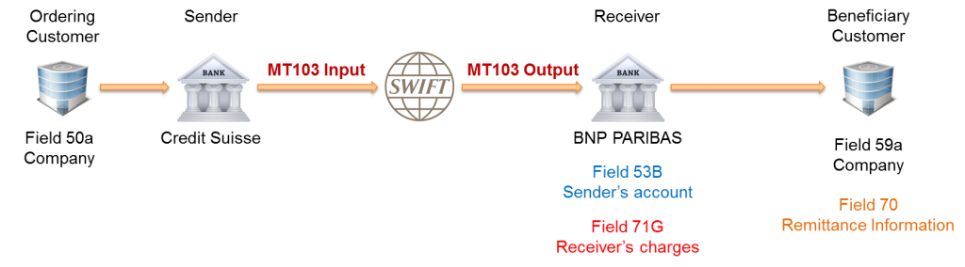
MT 103 Outward Remittance

Slide 14
MT 103 Message Format
The table contains information that is highlighted in the examples provided in the SWIFT message
Status | Tag | Field Name | Content / Options
M | 20 | Sender’s Reference | 16x
O | 13C | Time Indication | /8c/4!n1!x4!n
M | 23B | Bank Operation Code | 4!c
O | 23E | Instruction Code | 4!c[/30x]
O | 26T | Transaction Type Code | 3!c
M | 32A | Value Date/ Currency/ Interbank Settled Amount | 6!n3!a15d
O | 33B | Currency/Instructed Amount | 3!a15d
O | 36 | Exchange Rate | 12d
M | 50a | Ordering Customer | A, F, or K
O | 51A | Sending Institution | [/1!a][/34x]<crlf>4!a2!a2!c[3!c]

Slide 15
Status | Tag | Field Name | Content / Options
O | 52a | Ordering Institution | A or D
O | 53a | Sender’s Correspondent | A, B, or D
O | 54a | Receiver’s Correspondent | A, B, or D
O | 55a | Third Reimbursement Institution | A, B, or D
O | 56a | Intermediary Institution | A, C, or D
O | 57a | Account with Institution | A, B, C, or D
M | 59a | Beneficiary Customer | No letter option, A, or F
O | 70 | Remittance Information | 4*35x
M | 71A | Details of Charges | 3!a
O | 71F | Sender’s Charges | 3!a15d
O | 71G | Receiver's Charges | 3!a15d
O | 72 | Sender to Receiver Information | 6*35x
O | 77B | Regulatory Reporting | 3*35x
.

Slide 16
MT 103 Field 71 A - Charges
BEN (Beneficiary)
The Payee (recipient of the payment) will incur all of the payment transaction fees
The recipient will receive the payment minus the transfer charges
The Payer (sender of the payment) will not pay any payment fees
OUR
The Payer (sender of the payment) will bear of the payment transaction fees
The Payee (recipient of the payment) will not pay any payment fees
The beneficiary will receive the full amount of the payment
SHA (Shared)
The Payer (sender of the payment) will bear all fees charged by the sending bank
The Payee (recipient of the payment) will pay all fees charged by the receiving bank
The recipient will receive the payment minus any correspondent / intermediary fees

Slide 17
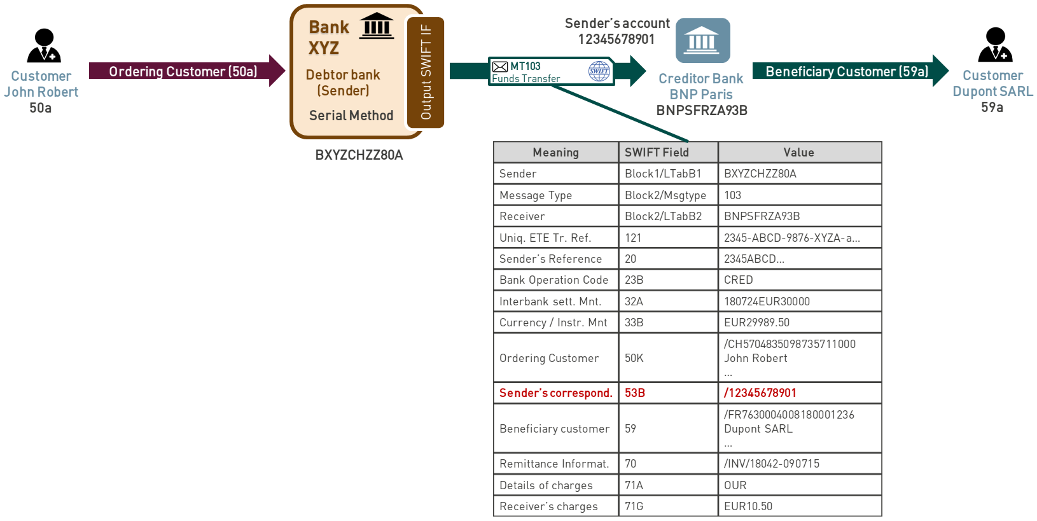
Example of MT 103 Swift Message

Slide 18
MT 190 Advice of Charges, Interest and Other Adjustments
This message type is sent by an account servicing institution to the account owner. It is used to advise charges, interest or other adjustments which have been debited or credited to the account owner's account. It provides details of charges which are previously unknown to the Receiver.
MT 190 Format Specification
Status | Tag | Field Name | Content / Options
M | 20 | Transaction Reference Number | 16x
M | 21 | Related Reference Number | 16x
M | 25 | Account Identification | 35x
M | 32a | Value Date, Currency Code, Amount | C or D
O | 52a | Ordering Institution | A or D
M | 71B | Details of Charges | 6*35x
O | 72 | Sender to Receiver Information | 6*35x

Slide 19
Charge Code used in MT 190
AMND | Amendment | Payment order was changed based on a request to do so from the (original) sending bank or as a result of receiving amended information from the (original) sending bank
CANF | Cancellation Fee | Used when fees are assessed for cancellation of payment
CLEF | Clearing Fee | Used when fees are assessed for standard processing of financial institution type transfers (category 2 MT payments)
COMM | Commission | Our Commission
INT | Interest | Interest related charges
INVS | Investigation | Used when charges are being assessed for investigation or request for information required to complete payment processing
NSTP | Non STP Charge | Charge for a payment that required an intervention during processing.
OURC | OUR charging option used | Claim is being submitted in response to receiving a customer payment with OUR in filed 71A Details of Charges

Slide 20
MT 191 – Request Payment of Charges, Interest and Other Expenses
This message type is sent by a financial institution to another financial institution.
It is used to request the payment of charges, interest and/or other expenses which are previously
unknown to the Receiver.
MT 191 – Format Specification
Status | Tag | Field Name | Content / Options
M | 20 | Transaction Reference Number | 16x
M | 21 | Related Reference | 16x
M | 32B | Currency Code, Amount | 3!a15d
O | 52a | Ordering Institution | A or D
O | 57a | Account with Institution | A, B, or D
M | 71B | Details of Charges | 6*35x
O | 72 | Sender to Receiver Information | 6*35x

Slide 21
MT 202 COV – Cover Payments
SWIFT MT202 Messages are used for interbank funds transfers. There is no customer involved when issuing an MT202. Funds are not sent on behalf of a customer but on behalf of the initial sending banking institution itself.
This message is sent by or on behalf of the ordering institution directly, or through correspondents, to the financial institution of the beneficiary institution. It must only be used to order the movement of funds related to an underlying customer credit transfer that was sent with the cover method.
It is specific to cover a single customer credit transfer (MT103), the MT 202 COV is not an alternative message type but the exclusive method to cover third party payments, it is not used to cover any other message types

Slide 22
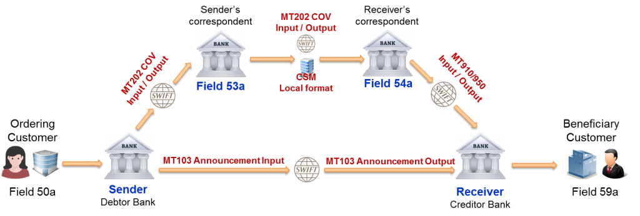
Cover Payment – MT 103 Single Customer Credit Transfer

Slide 23
When the cover method is used, the party (usually a bank) that transfers the funds, initiates two payments an MT 103 announcement for customer transfer and a cover (MT202COV)
The announcement is sent to the beneficiary bank to announce that funds are coming for a specific beneficiary. The announcement does not carry the funds. It just informs the bank of the beneficiary that 1)Funds are coming 2)From which beneficiary 3)The correspondent ( of the beneficiary bank) that will receive the funds. That is why it is called an announcement.
The cover payment (MT202COV) is sent by the sender to its correspondent. This is the message that really moves the funds. With the MT202 COV, the sender say to its correspondent “Please debit my account that you hold and the credit the beneficiary bank’s account with its correspondent” Note that the correspondent of sender and beneficiary are located in the same country. So this payment may go through a local clearing system and through SWIFT.
When the beneficiary bank receives the announcement, it might already credit its customer even if the funds (the cover) has not arrived yet. It depends on many criteria
A bank may decide to systematically wait for the cover if the transfer is in a specific currency
Payment above a certain threshold will be credited only after the cover is received
How good is the relationship of the bank with that party

Slide 24
MT 202 COV Message Format
The MT 202COV consist of two sequences:
Sequence A General Information is a single occurrence sequence and contains information on the financial institution transfer between the ordering institution and beneficiary institution.
Sequence B Underlying Customer Credit Transfer Details is a single occurrence sequence and is used to provide details on an individual underlying customer credit transfer that was sent with the cover method.
Status | Tag | Field Name | Content/Options
Mandatory Sequence A General Information
M | 20 | Transaction Reference Number | 16x
M | 21 | Related Reference | 16X
O | 13C | Time Indication | /8c/4!n1!x4!n

Slide 25
Status | Tag | Field Name | Contents/Options
M | 32A | Value Date, Currency Code, Amount | 6!n3!a15d
O | 52a | Ordering Institution | A or D
O | 53a | Sender’s Correspondent | A, B, or D
O | 54a | Receiver’s Correspondent | A, B, or D
O | 56a | Intermediary | A or D
O | 57a | Account With Institution | A, B, or D
M | 58a | Beneficiary Institution | A or D
O | 72 | Sender to Receiver Information | 6*35x
End of Sequence A General Information
Mandatory Sequence B Underlying Customer Credit Transfer Details
M | 50a | Ordering Customer | A, F, or K
O | 52a | Ordering Institution | A or D
O | 56a | Intermediary Institution | A, C, or D

Slide 26
Status | Tag | Field Name | Content / Options
O | 57a | Account with Institution | A, B, C, or D
M | 59a | Beneficiary Customer | No letter option, A, or F
O | 70 | Remittance Information | 4*35x
O | 72 | Sender to Receiver Information | 6*35x
O | 33B | Currency/Instructed Amount | 3!a15d
End of Sequence B Underlying Customer Credit Transfer Details

Slide 27
Example of MT 202 COV as cover of MT 103
Value 27 May 2009, Mr. Big orders Bank A, Brussels to pay an invoice with number 1234 of USD 10,500.00 to Mr. Small who has an account 987654321 with Bank B, London.
Bank A processes this transaction through cover method by sending:
A customer credit transfer message MT 103 to Bank B, using reference 090525/123COV.
A message MT 202 COV with reference 090525/124COV for the USD payment to its USD correspondent Bank C, New York for credit of Bank B, London on their account 123444555 at Bank D, New York.

Slide 28
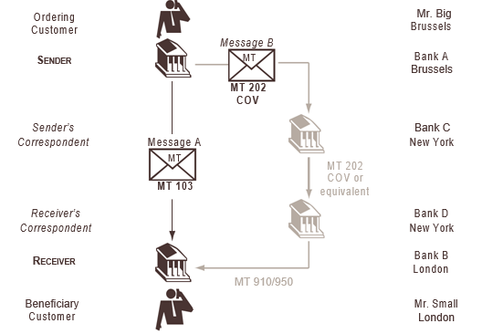

Slide 29
SWIFT Message MT 103
Explanation | Format
Sender | AAAABEBB
Message Type | 103
Receiver | BBBBGB22
Unique End to End Transaction Reference | 121:693eb10c-618b-456d-ac53-c0b0226b537c
Message Text
Sender’s Reference | :20:090525/123COV
Bank Operation Code | :23B:CRED
Value Date, Currency Code, Amount | :32A:090527USD10500,00
Currency Instructed Amount | :33B:USD10500,00
Ordering Customer | :50F:/123564982101 1/MR. BIG 2/HIGH STREET 3 3/BE/BRUSSELS

Slide 30
Explanation | Format
Sender’s Correspondent | :53A:CCCCUS33
Receiver’s Correspondent | :54A:DDDDUS33
Beneficiary Customer | :59F:/987654321 1/MR. SMALL 2/LOW STREET 15 3/GB/LONDON
Remittance Information | :70:/INV/1234
Details of Charges | :71A:SHA
End of message test/trailer

Slide 31
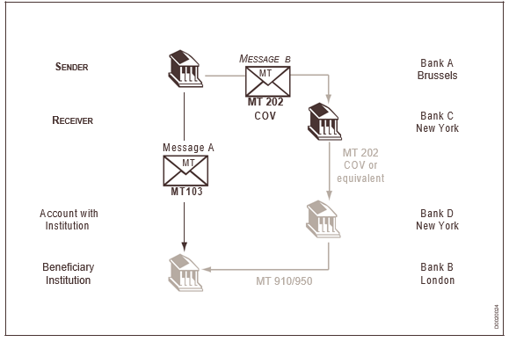
SWIFT MT 202 COV Flow

Slide 32
SWIFT Message MT 202 COV
Explanation | Format
Sender | AAAABEBB
Message Type | 202
Receiver | CCCCUS33
Validation Flag | 119:COV
Unique End to End Transaction Reference | 121:693eb10c-618b-456d-ac53-c0b0226b537c
Message Text General Information
Transaction Reference Number | :20:090525/124COV
Related Reference | :21:090525/123COV
Value Date, Currency Code, Amount | :32A:090527USD10500,00
Account With Institution | :57A:DDDDUS33

Slide 33
Explanation | Format
Beneficiary Institution | :58A:BBBBGB22
Underlying Customer Credit Transfer Details
Ordering Customer | :50F:/123564982101 1/MR. BIG 2/HIGH STREET 3 3/BE/BRUSSELS
Beneficiary Customer | :59F:/987654321 1/MR. SMALL 2/LOW STREET 15 3/GB/LONDON
Remittance Information | :70:/INV/1234
Currency, instructed Amount | :33B:USD10500,00
End of message text/trailer

Slide 34
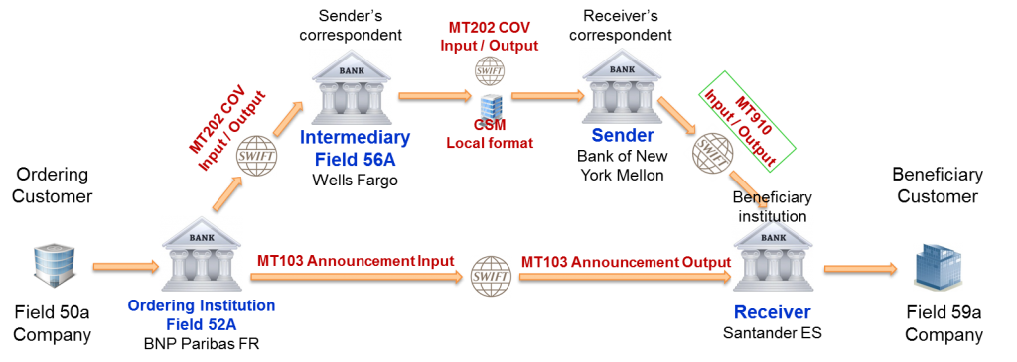
MT910 – Confirmation of Credit
The SWIFT MT 910 message is called Confirmation of Credit. It is sent to an account owner or to a party authorised by the account owner to receive that information. It indicates that funds have been credited to an account.

Slide 35
MT 910 – Message Format
Status | Tag | Field Name | Content/Options
M | 20 | Transaction Reference Number | 16x
M | 21 | Related Reference Number | 16x
M | 25a | Account Identification | No letter option or P
O | 13D | Time Indication | 6!n4!n1!x4!n
M | 32A | Value Date, Currency Code, Amount | 6!n3!a15d
O | 50a | Ordering Customer | A, F, or K
O | 52a | Ordering Institution | A or D
O | 56a | Intermediary | A or D
O | 72 | Sender to Receiver Information | 6*35x

Slide 36
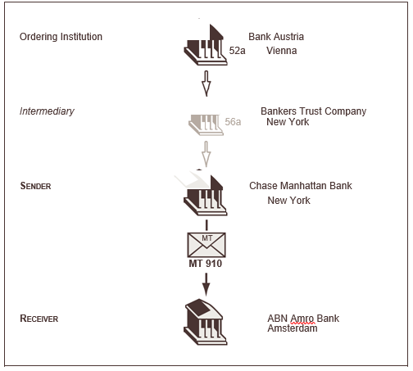
Example of MT 910 Workflow
Chase Manhattan Bank, New York, informs ABN Amro Bank, Amsterdam, of a credit to its account number 6-9412771, by order of Bank Austria, Vienna. The value date of the credit is 23 January 2014, for US dollars 500,000, and is received from Bankers Trust Company, New York. Swift format shown below
Chase Manhattan sends the following confirmation to ABN Amro:

Slide 37
Explanation | Format
Sender | CHASUS33
Message Type | 910
Receiver | ABNANL2A
Message Text
Transaction Reference Number | :20:C11126C9224
Related Reference | :21:494936/DEV
Account Identification | :25:6-9412771
Date/Time Indication | :13D:1401231426+0100
Value Date, Currency Code, Amount | :32A:140123USD500000,
Ordering Institution | :52A:BKAUATWW
Intermediary | :56A:BKTRUS33
End of Message Text/ Trailer

Slide 38
MT 192 – Request for Cancelation
Payment Cancelation should be submitted in structured form including full and correct payment details, payment reference, currency/amount, date of payment. The use of MT 192/MT292 Request for Cancelation is preferred with use of /FRAD/ in filed 79. For direct (MT103) and cover payments (MT202COV) should be cancelled in parallel.
To improve funds recovery, Payment cancelation should be treated with higher priority than standard inquiries and be considered urgent. The use of MT196/MT296 Response Message should be adopted to provide clear and immediate status updates and responses.
Standard Codes for Payment Cancelation
DUPL – Payment is duplicate of another payment
AGNT- Agent in the payment workflow is incorrect
CURR – Currency of the payment is incorrect
CUST – Cancellation requested by the debtor (ordering party)
UPAY – Payment is not justified
CUTA – Cancellation request because an investigation request has been received and no remediation is possible
TECH- Cancellation requested following technical problems resulting in erroneous transaction
FRAD – Cancellation request following a transaction that was originated fraudulently.

Slide 39
MT 192 Message Format
Status | Tag | Field Name | Content
M | 20 | Transaction Reference Number | 16x
M | 21 | Related Reference Number | 16X
M | 11S | MT and Date of the Original Message | 3!n 6!n [4!n6!n]
O | 79 | Narrative Description of the Original Message | 35*50x – Mention standard code for Cancelation of payment

Slide 40
MT 195 - Queries
This message type is:
• sent by a financial institution to another financial institution.
• sent by a corporate customer to a financial institution.
• sent by a financial institution to a corporate customer.
It is used to request information or clarification relating to a previous SWIFT or non-SWIFT message or to
one or more transactions contained therein.
A query may also be sent to request that an amendment be made to a previous message, except in those
cases where a specific message, or facility within a message, has been provided for this purpose in the
related category, for example, MT 707, AMEND in field 22 of the MT 300.

Slide 41
MT 195 Format Specification
Status | Tag | Field Name | Contents
M | 20 | Transaction Reference Number | 16x
M | 21 | Related Reference Number | 16x
M | 75 | Queries | 6*35x
O | 77A | Narrative | 20*35x
O | 11A | MT and Date of the Original Message to which Answer relates | R or S
O | 79 | Narrative description of the message to which the query relates | 35*50x

Slide 42
MT 196 – Answers – Responds to MT 192 Request for Cancelation
The purpose of MT 196 message is to respond to MT 192 Cancelation request message. This message type is sent by one financial institution to another financial institution
Status Codes for Cancelation Request Response
CNCL – Cancelled as requested
RJCR - Cancelation request is rejected
PDCR – Cancelation request is pending
Reason Codes when rejecting a Cancelation Request
LEGL – Reported when the cancellation cannot be accepted because of regulatory rules
CUST – Reported when the cancellation cannot be accepted because of customer decision (creditor)
ARDT – Cancellation not accepted as the transaction has already been returned
NOAS – No response from beneficiary ( to the cancellation request)

Slide 43
MT 196 Message Format
Status | Tag | Field Name | Contents
M | 20 | Transaction Reference Number | 16x
M | 21 | Related Reference Number | 16x
M | 76 | Answers | 6*35x
O | 77A | Narrative | 20*35x
O | 11A | MT and Date of the Original Message to which Answer relates

Slide 44
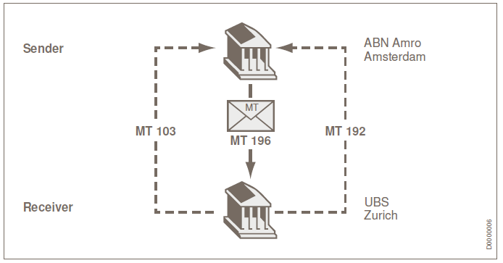
Example: Answer as a Result of a Request for Cancellation
On May 27, 2009, UBS, Zürich requests ABN Amro Amsterdam, to consider cancellation of its MT 103,
TRN 494932/DEV, sent on May 27, 2009.
ABN Amro confirms the cancellation of the Customer Transfer via an MT 196.

Slide 45
Explanation | Format
Sender | ABNANL2A
Message Type | 196
Receiver | UBSWCHZH80A
Message Text
Transaction Reference Number | :20:6457AZ
TRN of request for cancellation ( Related Reference) | :21:23191
Answer | :76:CANCELLED
MT and date of the original message | :11R:103 090527
End of message text/trailer

